Slide 1
Unit 2 The Next Step with Java
Lesson 5: Introduction to Defining Classes
Lesson 6: Control Statements Continued
Lesson 7: Improving the User Interface

Slide 2
Lesson 5: Introduction to Defining Classes

Slide 3
Lesson 5: Introduction to Defining Classes
Objectives:
Design and implement a simple class from user requirements.
Organize a program in terms of a view class and a model class.
Use visibility modifiers to make methods visible to clients and restrict access to data within a class.

Slide 4
Lesson 5: Introduction to Defining Classes
Objectives:
Write appropriate mutator methods, accessor methods, and constructors for a class.
Understand how parameters transmit data to methods.
Use instance variables, local variables, and parameters appropriately.
Organize a complex task in terms of helper methods.

Slide 5
Lesson 5: Introduction to Defining Classes
Vocabulary:
accessor
actual parameter
behavior
constructor
encapsulation
formal parameter
helper method
identity
instantiation
lifetime
mutator
scope
state
visibility modifier

Slide 6
5.1 The Internal Structure of Classes and Objects
An object is a run-time entity that contains data and responds to messages.
A class is a software package or template that describes the characteristics of similar objects.
These characteristics are of two sorts:
Variable declarations that define an object’s data requirements (instance variables).
Methods that define its behavior in response to messages.

Slide 7
5.1 The Internal Structure of Classes and Objects
The combining of data and behavior into a single software package is called encapsulation.
An object is an instance of its class, and the process of creating a new object is called instantiation.

Slide 8
5.1 The Internal Structure of Classes and Objects
Classes, Objects, and Computer Memory
When a Java program is executing, the computers memory must hold:
All class templates in their compiled form
Variables that refer to objects
Objects as needed
Each method’s compiled byte code is stored in memory as part of its class’s template.

Slide 9
5.1 The Internal Structure of Classes and Objects
Memory for data is allocated within objects.
All class templates are in memory at all times, individual objects come and go.
An object first appears and occupies memory when it is instantiated, and it disappears automatically when no longer needed.

Slide 10
5.1 The Internal Structure of Classes and Objects
The JVM knows if an object is in use by keeping track of whether or not there are any variables referencing it.
Because unreferenced objects cannot be used, Java assumes that it is okay to delete them from memory via garbage collection.

Slide 11
5.1 The Internal Structure of Classes and Objects
Three Characteristics of an Object
An object has behavior as defined by the methods of its class
An object has state, which is another way of saying that at any particular moment its instance variables have particular values.
Typically, the state changes over time in response to messages sent to the object.

Slide 12
5.1 The Internal Structure of Classes and Objects
An object has its own unique identity, which distinguishes it from all other objects in the computers memory.
An objects identity is handled behind the scenes by the JVM and should not be confused with the variables that might refer to the object.
When there are no variables the garbage collector purges the object from memory.

Slide 13
5.1 The Internal Structure of Classes and Objects
Clients, Servers, and Interfaces
When messages are sent, two objects are involved:
The sender (the client)
The receiver (the server)
Client:
A clients interactions with a server are limited to sending it messages.
A client needs to know only a servers interface, that is, the list of methods supported by the server.

Slide 14
5.1 The Internal Structure of Classes and Objects
Server
The server’s data requirements and the implementation of its methods are hidden from the client (information hiding).
Only the person who writes a class needs to understand its internal workings
A class’s implementation details can be changed radically without affecting any of its clients provided its interface remains the same.

Slide 15
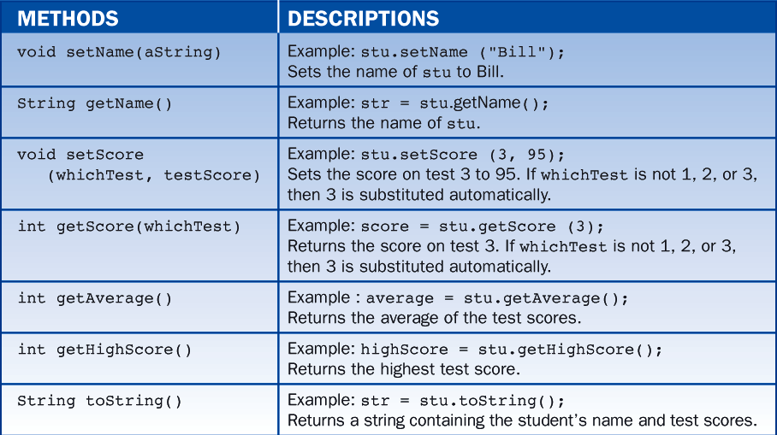
5.2 A Student Class
The student object stores a name and three test scores and responds to the message shown in Table 5-1.

Slide 16
5.2 A Student Class
Using Student Objects
Some portions of code illustrate how a client instantiates and manipulates student objects. First we declare several variables, including two variables of type Student.
As usual, we do not use variables until we have assigned them initial values. We assign a new student object to s1 using the operator new.
Student s1, s2; // Declare the variables
String str;
int i;
s1 = new Student(); // Instantiate a student and associate it with the
// variable s1

Slide 17
5.2 A Student Class
It is important to emphasize that the variable s1 is a reference to a student object and is not a student object itself.
A student object keeps track of the name and test scores of an actual student. Thus, for a brand new student object, what are the values of these data attributes?

Slide 18
5.2 A Student Class
That depends on the class’s internal implementation details, but we can find out easily by sending messages to the student object via its associated variable s1:
str = s1.getName();
System.out.println (str); // yields ""
i = s1.getHighScore();
System.out.println (i); // yields 0

Slide 19
5.2 A Student Class
Apparently, the name was initialized to an empty string and the test scores to zero. Now we set the object’s data attributes by sending it some messages:
s1.setName ("Bill"); // Set the student's name to "Bill"
s1.setScore (1,84); // Set the score on test 1 to 84
s1.setScore (2,86); // on test 2 to 86
s1.setScore (3,88); // on test 3 to 88

Slide 20
5.2 A Student Class
Messages that change an object’s state are called mutators.
To see if the mutators worked correctly, we use other messages to access the object’s state (called accessors):
str = s1.getName(); // str equals "Bill"
i = s1.getScore (1); // i equals 84
i = s1.getHighScore(); // i equals 88
i = s1.getAverage(); // i equals 86

Slide 21
5.2 A Student Class
The object’s string representation is obtained by sending the toString message to the object.
str = s1.toString();
// str now equals
// "Name: Bill\nTest 1: 84\nTest2: 86\nTest3: 88\nAverage: 86"

Slide 22
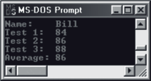
5.2 A Student Class
When displayed in a terminal window (Figure 5-1), the string is broken into several lines as determined by the placement of the newline characters (‘\n’).

Slide 23
5.2 A Student Class
In addition to the explicit use of the toString method, there are other situations in which the method is called automatically. For instance, toString is called implicitly when a student object is concatenated with a string or is in an argument to the method println:
str = "The best student is: \n" + s1;
// Equivalent to: str = "The best student is: \n" + s1.toString();
System.out.println (s1);
// Equivalent to: System.out.println (s1.toString());

Slide 24
5.2 A Student Class
Objects, Assignments, and Aliasing
We close this demonstration by associating a student object with the variable s2. Rather than instantiating a new student, we assign s1 to s2:
s2 = s1; // s1 and s2 now refer to the same student

Slide 25
5.2 A Student Class
The variables s1 and s2 now refer to the same student object.
This might come as a surprise because we might reasonably expect the assignment statement to create a second student object equal to the first, but that is not how Java works.
To demonstrate that s1 and s2 now refer to the same object, we change the students name using s2 and retrieve the same name using s1:
s2.setName ("Ann"); // Set the name
str = s1.getName(); // str equals "Ann". Therefore, s1 and s2 refer
// to the same object.

Slide 26
5.2 A Student Class
Table 5-2 shows code and a diagram that clarify the manner in which variables are affected by assignment statements. At any time, it is possible to break the connection between a variable and the object it references. Simply assign the value null to the variable:
Student s1;
s1 = new Student(); // s1 references the newly instantiated student
... // Do stuff with the student
s1 = null; // s1 no longer references anything

Slide 27
5.2 A Student Class
Table 5-2 demonstrates that assignment to variables of numeric types such as int produces genuine copies, whereas assignment to variables of object types does not.

Slide 28
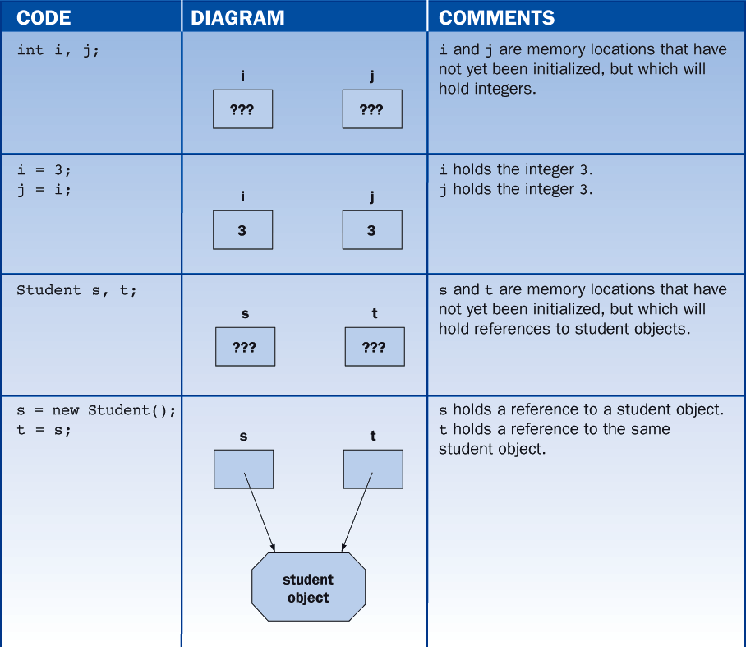
5.2 A Student Class

Slide 29
5.2 A Student Class
Primitive Types, Reference Types, and the null Value
Two or more variables can refer to the same object.
In Java, all types fall into two fundamental categories
Primitive types: int, double, boolean, char, and the shorter and longer versions of these
Reference types: all classes, for instance, String, Student, KeyboardReader, and so on

Slide 30
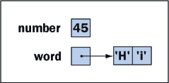
5.2 A Student Class
A variable of a primitive type is best viewed as a box that contains a value of that primitive type.
A variable of a reference type is thought of as a box that contains a pointer to an object.
The state of memory after the following code is executed is shown in figure 5-2
int number = 45;
String word = “Hi”;

Slide 31
5.2 A Student Class
Reference variables can be assigned the value null.
If a reference variable previously pointed to an object, and no other variable currently points to that object, the computer reclaims the object’s memory during garbage collection.
Student student = new student (“Mary”, 70, 80, 90);
student = null;

Slide 32
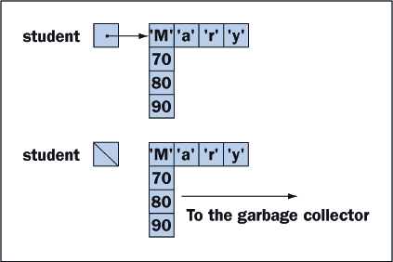
5.2 A Student Class
The Student variable before and after it has been assigned the value null

Slide 33
5.2 A Student Class
A reference variable can be compared to the null value, as follows:
if (student == null)
// Don't try to run a method with that student!
else
// Process the student
while (student != null){
// Process the student
// Obtain the next student from whatever source
}

Slide 34
5.2 A Student Class
When a program attempts to run a method with an object that is null, Java throws a null pointer exception, as in the following example:
String str = null;
System.out.println (str.length()); // OOPS! str is null, so Java throws a
// null pointer exception

Slide 35
5.2 A Student Class
The Structure of a Class Template
All classes have a similar structure consisting of four parts:
The class’s name and some modifying phrases
A description of the instance variables
One or more methods that indicate how to initialize a new object (called constructor methods)
One or more methods that specify how an object responds to messages
The order of these parts can be varied arbitrarily provided (the class’s name) comes first.

Slide 36
5.2 A Student Class
The following is an example of a class template:
public class <name of class> extends <some other class>{
// Declaration of instance variables
private <type> <name>;
...
// Code for the constructor methods
public <name of class>() {
// Initialize the instance variables
...
}
...
// Code for the other methods
public <return type> <name of method> (<parameter list>){
...
}
...
}

Slide 37
5.2 A Student Class
Class definitions usually begin with the keyword public, indicating that the class is accessible to all potential clients.
public class
Class names are user-defined symbols, and must adhere to the rules for naming variables and methods.
It is common to start class names with a capital letter and variable and method names with a lowercase letter.
<name of class>

Slide 38
5.2 A Student Class
Java organizes its classes in a hierarchy. At the base of this hierarchy is a class called Object.
In the hierarchy, if class A is immediately above another class B, we say that A is the superclass or parent of B and B is a subclass or child of A.
Each class, except Object, has exactly one parent and can have any number of children.
extends <some other class>

Slide 39
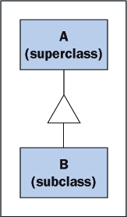
5.2 A Student Class
Relationship between superclass and subclass

Slide 40
5.2 A Student Class
When a new class is created, it is incorporated into the hierarchy by extending an existing class
The new class’s exact placement in the hierarchy is important because a new class inherits the characteristics of its superclass through a process called inheritance.
If the clause extends <some other class> is omitted from the new class’s definition, then by default, the new class is assumed to be a subclass of Objects.

Slide 41
5.2 A Student Class
Instance variables are nearly always declared to be private.
This prevents clients from referencing to the instance variables directly.
Making instance variables private is an important aspect of information hiding.
private <type> <name>

Slide 42
5.2 A Student Class
Methods are usually declared to be public, which allows clients to refer to them.
public <return type> <name of method>
The clauses private and public are called visibility modifiers.
Omitting the visibility modifier is equivalent to using public.

Slide 43
5.2 A Student Class
Implementation of the Student Class
/* Student.java
Manage a student's name and three test scores.
*/
public class Student {
//Instance variables
//Each student object has a name and three test scores
private String name; //Student name
private int test1; //Score on test 1
private int test2; //Score on test 2
private int test3; //Score on test 3
//Constructor method
public Student(){
//Initialize a new student's name to the empty string and the test
//scores to zero.
name = "";
test1 = 0;
test2 = 0;
test3 = 0;
}

Slide 44
5.2 A Student Class
//Other methods
public void setName (String nm){
//Set a student's name
name = nm;
}
public String getName (){
//Get a student's name
return name;
}
public void setScore (int i, int score){
//Set test i to score
if (i == 1) test1 = score;
else if (i == 2) test2 = score;
else test3 = score;
}

Slide 45
5.2 A Student Class
public int getScore (int i){
//Retrieve score i
if (i == 1) return test1;
else if (i == 2) return test2;
else return test3;
}
public int getAverage(){
//Compute and return the average
int average;
average = (int) Math.round((test1 + test2 + test3) / 3.0);
return average;
}
public int getHighScore(){
//Determine and return the highest score
int highScore;
highScore = test1;
if (test2 > highScore) highScore = test2;
if (test3 > highScore) highScore = test3;
return highScore;
}

Slide 46
5.2 A Student Class
public String toString(){
//Construct and return a string representation of the student
String str;
str = "Name: " + name + "\n" + // "\n" denotes a newline
"Test 1: " + test1 + "\n" +
"Test 2: " + test2 + "\n" +
"Test 3: " + test3 + "\n" +
"Average: " + getAverage();
return str;
}
}

Slide 47
5.2 A Student Class
In the preceding example all the methods, except the constructor method, have a return type, although the return type may be void, indicating that the method in fact returns nothing.
In summary when an object receives a message, the object activates the corresponding method. The method then manipulates the object’s data as represented by the instance variables.

Slide 48
5.2 A Student Class
Constructors
The principal purpose of a constructor is to initialize the instance variables of a newly instantiated object.
Constructors are activated when the keyword new is used and at no other time.
A constructor is never used to reset instance variables of an existing object.

Slide 49
5.2 A Student Class
A class template can include more than one constructor, provided each has a unique parameter list; however, all the constructors must have the same name- that is, the name of the class.
Constructors with empty parameter lists and are called default constructors.
If a class template contains no constructors tha JVM provides a primitive default constructor.
This constructor initializes numeric variables to zero and object variables to null, thus indicating that the object variables currently reference no objects.

Slide 50
5.2 A Student Class
To illustrate we add several constructors to the student class.
// Default constructor -- initialize name to the empty string and
// the test scores to zero.
public Student(){
name = "";
test1 = 0;
test2 = 0;
test3 = 0;
}
// Additional constructor -- initialize the name and test scores
// to the values provided.
public Student(String nm, int t1, int t2, int t3){
name = nm;
test1 = t1;
test2 = t2;
test3 = t3;
}
// Additional constructor -- initialize the name and test scores
// to match those in the parameter s.
public Student(Student s){
name = s.name;
test1 = s.test1;
test2 = s.test2;
test3 = s.test3;
}

Slide 51
5.2 A Student Class
Chaining Constructors
When a class includes several constructors, the code for them can be simplified by chaining them.
The three constructors in the Student class each do the same thing – initialize the instance variables.
Simplify the code for the first and third constructors by calling the second constructor.
To call one constructor from another constructor, we use the notation:
this (<parameters>);

Slide 52
5.2 A Student Class
Thus, the code for the constructors becomes:
// Default constructor -- initialize name to the empty string and
// the test scores to zero.
public Student(){
this("", 0, 0, 0);
}
// Additional constructor -- initialize the name and test scores
// to the values provided.
public Student(String nm, int t1, int t2, int t3){
name = nm;
test1 = t1;
test2 = t2;
test3 = t3;
}
// Additional constructor -- initialize the name and test scores
// to match those in the parameter s.
public Student(Student s){
this(s.name, test1, s.test2, s.test3);
}

Slide 53
5.3 Editing, Compiling, and Testing the Student Class
To use the student class, we must save it in a file called Student.java and compile it by typing the following in a terminal window:
javac Student.java
If there are no compile-time errors, the compiler creates the byte code file Student.class

Slide 54
5.3 Editing, Compiling, and Testing the Student Class
Once the Student class is compiled, applications can declare and manipulate student objects provided that:
The code for the application and Student.class are in the same directory or
The Student.class is part of a package

Slide 55
5.3 Editing, Compiling, and Testing the Student Class
The following is a small program that uses and tests the student class:
public class TestStudent{
public static void main (String[] args){
Student s1, s2;
String str;
int i;
s1 = new Student(); // Instantiate a student object
s1.setName ("Bill"); // Set the student's name to "Bill"
s1.setScore (1,84); // Set the score on test 1 to 84
s1.setScore (2,86); // on test 2 to 86
s1.setScore (3,88); // on test 3 to 88
System.out.println("\nHere is student s1\n" + s1);
s2 = s1; // s1 and s2 now refer to the same object
s2.setName ("Ann"); // Set the name through s2
System.out.println ("\nName of s1 is now: " + s1.getName());
}
}

Slide 56
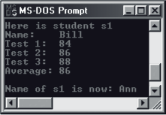
5.3 Editing, Compiling, and Testing the Student Class
Figure 5-5 shows the results of running such a program.

Slide 57
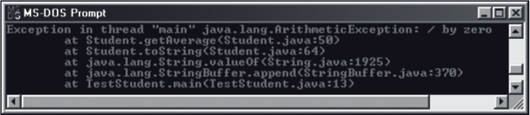
5.3 Editing, Compiling, and Testing the Student Class
Finding the Locations of Run-time Errors
The messages indicate that
An attempt was made to divide by zero in the Student class’s getAverage method (line 50)
Which had been called from the Student class’s toString method (line 64)
Which had been called by some methods we did not write.
Which, finally, had been called from the TestStudent class’s main method (line 13)

Slide 58
5.3 Editing, Compiling, and Testing the Student Class
Following are the lines of code mentioned:
Student getAverage line 50 :
average = (int) Math.round ((test1 + test2 + test3) / average);
Student toString line 64 :
"Average: " + getAverage();
TestStudent main line 13 :
System.out.println ("\nHere is student s1\n" + s1);

Slide 59
5.3 Editing, Compiling, and Testing the Student Class
We can now unravel the error.
In line 13 of main, the concatenation (+) of s1 makes an implicit call s1.toString().
In line 64 of toString, the getAverage method is called.
In line 50 of getAverage, a division by zero occurs.

Slide 60
5.4 The Structure and Behavior of Methods
The Structure of a Method Definition
Methods generally have the following form:
<visibility modifier> <return type> <method name> (<parameter list>){
<implementing code>
}

Slide 61
5.4 The Structure and Behavior of Methods
Return Statements
If a method has a return type, its implementing code must have at least one return statement that returns a value of that type.
There can be more than one return statement in a method; however, the first one executed ends the method.
A return statement in a void method quits the method and returns nothing.

Slide 62
5.4 The Structure and Behavior of Methods
The following is an example of a method that has two return statements but executes just one of them:
boolean odd(int i){
if (i % 2 == 0)
return false;
else
return true;
}

Slide 63
5.4 The Structure and Behavior of Methods
Formal and Actual Parameters
Parameters listed in a method’s definition are called formal parameters. Values passed to a method when it is invoked are called arguments or actual parameters.
// Client code
Student s = new Student();
KeyboardReader reader = new KeyboardReader();
int testScore = reader.readInt("Enter a test score:");
s.setScore(1, testScore);
// Server code
public void setScore (int i, int score){
if (i == 1) test1 = score;
else if (i == 2) test2 = score;
else test3 = score;
}

Slide 64
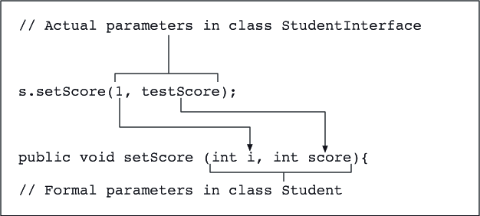
5.4 The Structure and Behavior of Methods
Parameter passing

Slide 65
5.4 The Structure and Behavior of Methods
When a method has a multiple parameters, the caller must provide the right number and types of values.
The actual parameters must match the formal parameters in position and type.
The rules for matching the types of a formal and an actual parameter are similar to those for assignment statements.

Slide 66
5.4 The Structure and Behavior of Methods
The actual parameter’s type must be either the same as or less inclusive than the type of the corresponding formal parameter.
For example, the method Math.sqrt, which has a single formal parameter of type double, can receive either a double or an int as an actual parameter from the caller.

Slide 67
5.4 The Structure and Behavior of Methods
Parameters and Instance Variables
The purpose of a parameter is to pass information to a method.
The purpose of an instance variable is to maintain information in an object.
These roles are clearly shown in the method setScore in figure 5-8.
This method receives the score in the formal parameter score.
This value is then transferred to one of the instance variables test1, test2, test3.

Slide 68
5.4 The Structure and Behavior of Methods
Local Variables
Occasionally, it is convenient to have temporary working storage for data in a method.
The programmer can declare local variables for this purpose.
The following example declares a variable average, assigns it the result of computing the average of the integer instance variables, and returns its value.

Slide 69
5.4 The Structure and Behavior of Methods
Note that there is no need for the method to receive data from the client, so we do not use a parameter.
There is no need for the object to remember the average, so we do not use an instance variable for that.
public int getAverage(){
int average;
average = (int) Math.round((test1 + test2 + test3) / 3.0);
return average;
}

Slide 70
5.4 The Structure and Behavior of Methods
Helper Methods
Occasionally, a task performed by a method becomes so complex that it helps to break it into subtasks to be solved by several other methods.
A class can define one or more methods to serve as helper methods.
Helper methods are usually private, because only methods already defined within the class need to use them.

Slide 71
5.4 The Structure and Behavior of Methods
For example, it is helpful to define a debug when testing a class.
This method expects a string and a double as parameters and displays these values in the terminal window.
private void debug(String message, double value) {
System.out.println(message + “ ” + value);
}

Slide 72
5.4 The Structure and Behavior of Methods
The advantage to this approach is that debugging statements throughout the class can be turned on or off by commenting out a single line of code:
private void debug(String message, double value) {
//System.out.println(message + “ ” + value);
}

Slide 73
5.5 Scope and Lifetime of Variables
A class definition consists of two principal parts:
a list of instance variables and
a list of methods.
When an object is instantiated, it receives its own complete copy of the instance variables, and when it is sent a message, it activates the corresponding method in its class.
It is the role of objects to contain data and to respond to messages
It is the role of classes to provide a template for creating objects and to store the code for methods.

Slide 74
5.5 Scope and Lifetime of Variables
When a method is executing, it does so on behalf of a particular object, and the method has complete access to the object's instance variables.
The instance variables form a common pool of variables accessible to all the class's methods, called global variables.
Variables declared within a method are called local variables.

Slide 75
5.5 Scope and Lifetime of Variables
Scope of Variables
The scope of a variable is that region of the program within which it can validly appear in lines of code.
The scope of a parameter or a local variable is restricted to the body of the method that declares it
The scope of a global or instance variable is all the methods in the defining class.
The compiler flags as an error any attempt to use variables outside of their scope.

Slide 76
5.5 Scope and Lifetime of Variables
Following is an example that illustrates the difference between local and global scope:
public class ScopeDemo {
private int iAmGlobal;
public void clientMethod (int parm){
int iAmLocal;
...
private int helperMethod (int parm1, int parm2){
int iAmLocalToo;
...
}
...

Slide 77
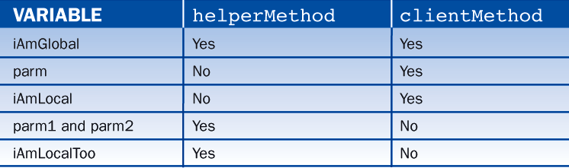
5.5 Scope and Lifetime of Variables
Table 5-3 shows where each of the variables and parameters can be used (i.e., its scope):
Notice that formal parameters are also local in scope, that is, their visibility is limited to the body of the method in which they are declared.

Slide 78
5.5 Scope and Lifetime of Variables
Block Scope
Within the code of a method, there can also be nested scopes.
Variables declared within any compound statement enclosed in {} are said to have block scope.
They are visible only within the code enclosed by {}.

Slide 79
5.5 Scope and Lifetime of Variables
For example, consider the following for loop to sum 10 input numbers:
int sum = 0;
KeyboardReader reader = new KeyboardReader();
for (int i = 1; i <= 10; i++){
int number = reader.readInt("Enter a number: ");
sum += number;
}
System.out.println("The sum is " + sum);

Slide 80
5.5 Scope and Lifetime of Variables
Lifetime of Variables
The lifetime of a variable is the period during which it can be used.
Local variables and formal parameters exist during a single execution of a method.
Each time a method is called, it gets a fresh set of formal parameters and local variables
Once the method stops executing, the formal parameters and local variables are no longer accessible.

Slide 81
5.5 Scope and Lifetime of Variables
Instance variables last for the lifetime of an object.
When an object is instantiated, it gets a complete set of fresh instance variables.
These variables are available every time a message is sent to the object, and they, in some sense, serve as the object's memory.
When the object stops existing, the instance variables disappear too.

Slide 82
5.5 Scope and Lifetime of Variables
Duplicating Variable Names
Because the scope of a formal parameter or local variable is restricted to a single method, the same name can be used within several different methods without causing a conflict.
When the programmer reuses the same local name in different methods, the name refers to a different area of storage in each method.
In the next example, the names iAmLocal and parm1 are used in two methods in this way:

Slide 83
5.5 Scope and Lifetime of Variables
public class ScopeDemo {
private int iAmGlobal;
public void clientMethod (int parm1){
int iAmLocal;
...
}
private int helperMethod (int parm1, int parm2){
int iAmLocal;
...
}
...
}

Slide 84
5.5 Scope and Lifetime of Variables
When to Use Instance Variables, Parameters, and Local Variables
The only reason to use an instance variable is to remember information within an object.
The only reason to use a parameter is to transmit information to a method.
The only reason to use a local variable is for temporary working storage within a method.
A very common mistake is to misuse one kind of variable for another.
Following are the most common examples of these types of mistakes:

Slide 85
5.5 Scope and Lifetime of Variables
A GLOBAL VARIABLE IS USED FOR TEMPORARY WORKING STORAGE
The method runs correctly only the first time.
The next time the method is called, it adds scores to the sum of the previous call, thus producing a much higher average than expected.
private int sum;
...
public int getAverage(){
for (int i = 1; i <= 3; i++)
sum += getScore(i);
return (int) Math.round(sum / 3.0);
}

Slide 86
5.5 Scope and Lifetime of Variables
A LOCAL VARIABLE IS USED TO REMEMBER INFORMATION IN AN OBJECT
This mistake can lead to errors in cases where the programmer uses the same name for a local variable and a global variable.
In this case, the variable name has been accidentally "localized" by prefixing it with a type name.
Thus, the value of the parameter nm is transferred to the local variable instead of the instance variable, and the Student object does not remember this change.
public void setName (String nm){
//Set a student's name
String name = nm; //Whoops! we have just declared name local.
}

Slide 87
5.5 Scope and Lifetime of Variables
A METHOD ACCESSES DATA BY DIRECTLY REFERENCING A GLOBAL VARIABLE WHEN IT COULD USE A PARAMETER INSTEAD
// Server class
public class ServerClass{
private int x;
public void m1(){
…
x = 0; // The real source of the error
}
public void m2(){
int y = 10 / x; // Exact spot of run-time error
}
…
}

Slide 88
5.5 Scope and Lifetime of Variables
// Client class
public class ClientClass{
public void m3(){
m1(); // Misuse of x occurs, but is hidden from client
m2(); // Run-time error occurs
}
…
}

Slide 89
5.6 Turtle Graphics: Colors, Pen Widths, and Movement
Color
The default color of a pen in turtle graphics is blue.
To can change the color of a pen, send it the setColor message.
This message expects a parameter of type Color, which is included in the package java.awt.
The following code segment draws a vertical red line using the constant Color.red:
import java.awt.Color;
…
StandardPen pen = new StandardPen();
pen.setColor(Color.red);
pen.move(50);

Slide 90
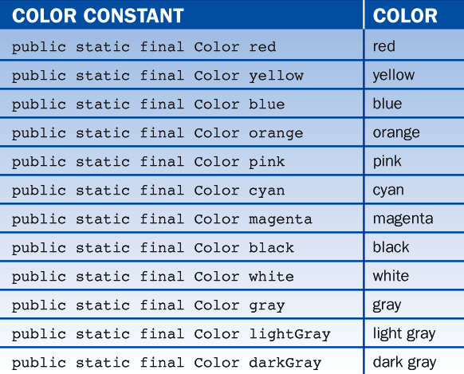
5.6 Turtle Graphics: Colors, Pen Widths, and Movement
The Color class includes several other constants to express commonly used colors, as shown in Table 5-4.

Slide 91
5.6 Turtle Graphics: Colors, Pen Widths, and Movement
Pen Width
The default width of a pen is two pixels (picture elements).
For a finer or broader stroke, reset this value by sending the message setWidth to a pen.
This message requires an integer parameter specifying the number of pixels.
For example, the next line of code sets a pen's width to 5 pixels:
pen.setWidth(5);

Slide 92
5.6 Turtle Graphics: Colors, Pen Widths, and Movement
A New Way to Move
The move method makes the pen move a given number of pixels in its current direction.
To move a pen to a given position from its current position, use the TurtleGraphics package (it includes another version of move that expects the coordinates of the new position as parameters.)
The expression move(0,0) does the same thing as home().
The parameters to this method can be any coordinates in the Cartesian system, where the origin (0,0) is the pen's home position at the center of the graphics window.

Slide 93
5.6 Turtle Graphics: Colors, Pen Widths, and Movement
Note that the method move(aDistance) and move(x, y) have the same name but do different things.
This is an example of overloaded methods, that is, two or more methods in a class having the same name but differing in either the number or type of their parameters.
Table 5-5 provides a complete list of the pen messages.

Slide 94
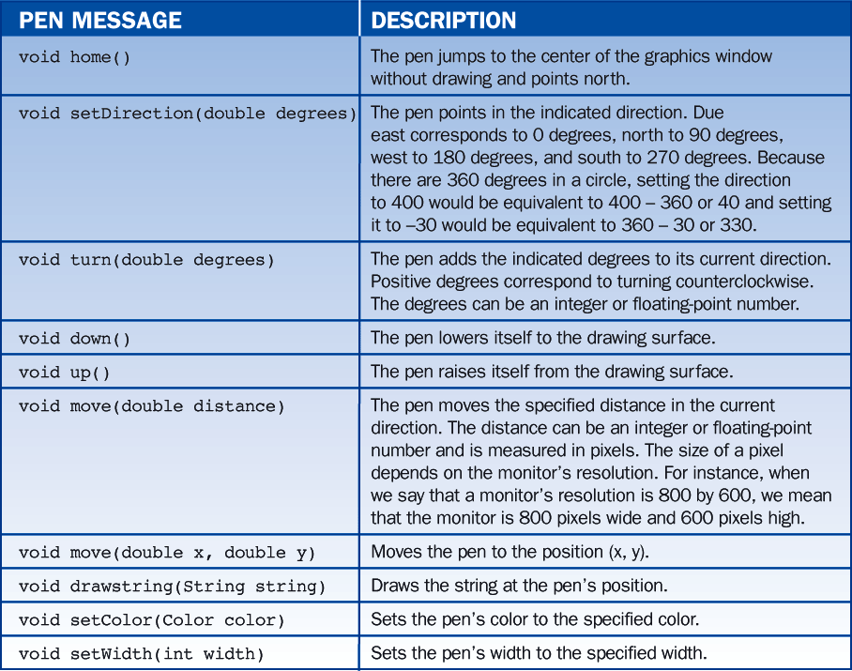
5.6 Turtle Graphics: Colors, Pen Widths, and Movement

Slide 95
Lesson 6: Control Statements Continued

Slide 96
Lesson 6: Control Statements Continued
Objectives:
Construct complex Boolean expressions using the logical operators && (AND), || (OR), and ! (NOT).
Understand the logic of nested if statements and extended if statements.
Construct nested loops.
Construct truth tables for Boolean expressions.
Create appropriate test cases for if statements and loops.

Slide 97
Lesson 6: Control Statements Continued
Vocabulary:
arithmetic overflow
boundary condition
combinatorial explosion
complete code testingcoverage
equivalence class
extended if statement
extreme condition
logical operator
nested if statement
nested loop
quality assurance
robust
truth table

Slide 98
6.1 Logical Operators
Java includes three logical operators equivalent in meaning to the English words AND, OR, and NOT.
These operators are used in the Boolean expressions that control the behavior of if, while, and for statements.
For instance, consider the following sentences:
If the sun is shining AND it is 8 am then let's go for a walk else let's stay home.
If the sun is shining OR it is 8 am then let's go for a walk else let's stay home.
If NOT the sun is shining then let's go for a walk else let's stay home.

Slide 99
6.1 Logical Operators
The phrases "the sun is shining" and "it is 8 am" are operands and the words AND, OR, and NOT are operators.
In the first sentence, the operator is AND.
Consequently, if both operands are true, the condition as a whole is true. If either or both are false, the condition is false.
In the second sentence, which uses OR, the condition is false only if both operands are false; otherwise, it is true.
In the third sentence, the operator NOT has been placed before the operand, as it would be in Java.
If the operand is true, then the NOT operator makes the condition as a whole false.

Slide 100
6.1 Logical Operators
We summarize these observations in the three parts of Table 6-1.
Each part is called a truth table, and it shows how the value of the overall condition depends on the values of the operands.
When there is one operand, there are two possibilities. For two operands, there are four; and for three operands, there are eight.
In general there are 2^{n} combinations of true and false for n operands.

Slide 101
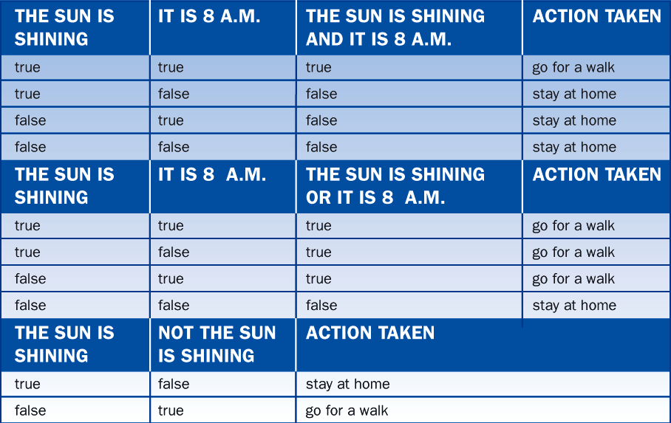
6.1 Logical Operators

Slide 102
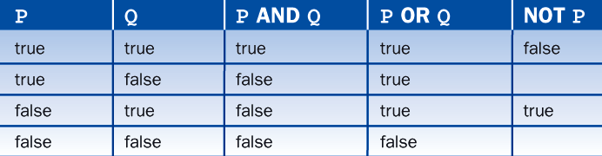
6.1 Logical Operators
Dropping the column labeled "action taken," we can combine the three truth tables into one, as illustrates in Table 6-2.
The letters P and Q represent the operands.

Slide 103
6.1 Logical Operators
If (the sun is shining AND it is 8 am) OR (NOT your brother is visiting) then let's go for a walk else let's stay at home.
Expressions inside parentheses are evaluated before those that are not.
We will go for a walk at 8 A.M. on sunny days or when your brother does not visit.
If the sun is shining AND (it is 8 A.M. OR (NOT your brother is visiting)) then let's go for a walk else let's stay at home.
Before we go for a walk, the sun must be shining.
In addition, one of two things must be true.
Either it is 8 am or your brother is not visiting.

Slide 104
6.1 Logical Operators
Java's Logical Operators and Their Precedence
In Java the operators AND, OR, and NOT are represented by &&, ||, and !, respectively.
Their precedence is shown in Table 6-3.
Observe that NOT (!) has the same high precedence as other unary operators, while AND (&&) and OR (||) have low precedence, with OR below AND.

Slide 105
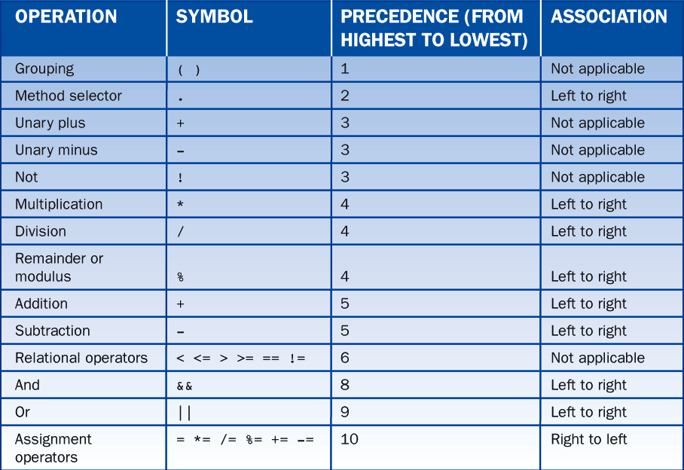
6.1 Logical Operators

Slide 106
6.1 Logical Operators
Examples
Following are some illustrative examples based on the employment practices at ABC Company.
The company screens all new employees by making them take two written tests.
A program then analyzes the scores and prints a list of jobs for which the applicant is qualified. Here is the relevant code:

Slide 107
6.1 Logical Operators
KeyboardReader reader = new KeyboardReader();
int score1, score2;
score1 = reader.readInt("Enter the first test score: ");
score2 = reader.readInt("Enter the second test score: ");
// Managers must score well (90 or above) on both tests.
if (score1 >= 90 && score2 >= 90)
System.out.println("Qualified to be a manager");
// Supervisors must score well (90 or above) on just one test
if (score1 >= 90 || score2 >= 90)
System.out.println("Qualified to be a supervisor");
// Clerical workers must score moderately well on one test
// (70 or above), but not badly (below 50) on either.
if ((score1 >= 70 || score2 >= 70) &&
!(score1 < 50 || score2 < 50))
System.out.println("Qualified to be a clerk");

Slide 108
6.1 Logical Operators
Boolean Variables
The complex Boolean expressions in the preceding examples can be simplified by using Boolean variables.
A Boolean variable can be true or false and is declared to be of type boolean.

Slide 109
6.1 Logical Operators
KeyboardReader reader = new KeyboardReader();
int score1, score2;
boolean bothHigh, atLeastOneHigh, atLeastOneModerate, noLow;
score1 = reader.readInt("Enter the first test score: ");
score2 = reader.readInt("Enter the second test score: ");
bothHigh = (score1 >= 90 && score2 >= 90); // parentheses
atLeastOneHigh = (score1 >= 90 || score2 >= 90); // optional
atLeastOneModerate = (score1 >= 70 || score2 >= 70); // here
noLow = !(score1 < 50 || score2 < 50);
if (bothHigh)
System.out.println("Qualified to be a manager");
if (atLeastOneHigh)
System.out.println("Qualified to be a supervisor");
if (atLeastOneModerate && noLow)
System.out.println("Qualified to be a clerk");

Slide 110
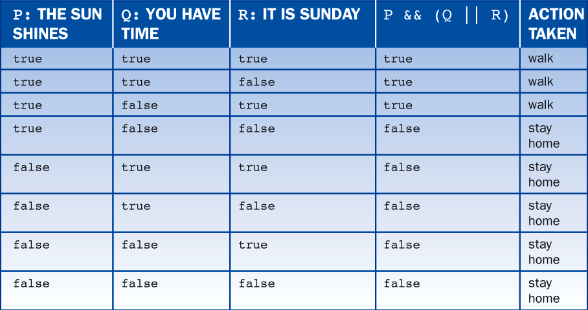
6.1 Logical Operators
In order to rewrite the previous code, we first create a truth table for the complex if statement, as shown in Table 6-4.

Slide 111
6.1 Logical Operators
Then implement each line of the truth table with a separate if statement involving only && (AND) and ! (NOT).
Applying the technique here yields:
if ( the sun shines && you have time && it is Sunday) walk;
if ( the sun shines && you have time && !it is Sunday) walk;
if ( the sun shines && !you have time && it is Sunday) walk;
if ( the sun shines && !you have time && !it is Sunday) stay home;
if (!the sun shines && you have time && it is Sunday) stay home;
if (!the sun shines && you have time && !it is Sunday) stay home;
if (!the sun shines && !you have time && it is Sunday) stay home;
if (!the sun shines && !you have time && !it is Sunday) stay home;

Slide 112
6.1 Logical Operators
In this particular example, the verbosity can be reduced without reintroducing complexity by noticing that the first two if statements are equivalent to:
if ( the sun shines && you have time) walk;
And the last four are equivalent to
if (!the sun shines) stay home;
Putting all this together yields:
if ( the sun shines && you have time) walk;
if ( the sun shines && !you have time && it is Sunday) walk;
if (!the sun shines) stay home;

Slide 113
6.1 Logical Operators
Some Useful Boolean Equivalences
There is often more than one way to write a Boolean expression.
For instance, the following pairs of Boolean expressions are equivalent as truth tables readily confirm:
!(p || q) equivalent to !p && !q
!(p && q) equivalent to !p || !q
p || (q && r) equivalent to (p || q) && (p || r)
p && (q || r) equivalent to (p && q) || (p && r)

Slide 114
6.1 Logical Operators
Short-circuit evaluation
The Java virtual machine sometimes knows the value of a Boolean expression before it has evaluated all of its parts.
In the expression (p && q), if p is false, then so is the expression, and there is no need to evaluate q.
When evaluation stops as soon as possible, is called short-circuit evaluation.
In contrast, some programming languages use complete evaluation in which all parts of a Boolean expression are always evaluated.

Slide 115
6.2 Testing if Statements
Quality assurance is the ongoing process of making sure that a software product is developed to the highest standards possible subject to the ever-present constraints of time and money.
Faults are fixed most inexpensively early in the development life cycle.
Test data should try to achieve complete code coverage, which means that every line in a program is executed at least once.

Slide 116
6.2 Testing if Statements
All the sets of test data that exercise a program in the same manner are said to belong to the same equivalence class, which means they are equivalent from the perspective of testing the same paths through the program.
The test data should also include cases that assess a program's behavior under boundary conditions - that is, on or near the boundaries between equivalence classes.
We should test under extreme conditions - that is, with data at the limits of validity.

Slide 117
6.2 Testing if Statements
Data validation rules should also be tested.
We need to enter values that are valid and invalid, and we must test the boundary values between the two.

Slide 118
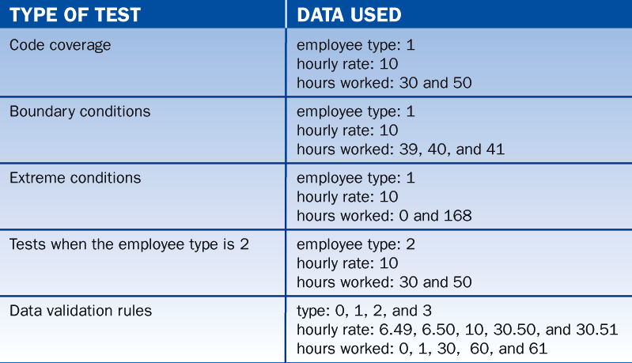
6.2 Testing if Statements
Table 6-5 summarizes our planned tests:

Slide 119
6.3 Nested if Statements
Here is an everyday example of nested if's written in Javish:
if (the time is after 7 PM){
if (you have a book)
read the book;
else
watch TV;
}else
go for a walk;

Slide 120
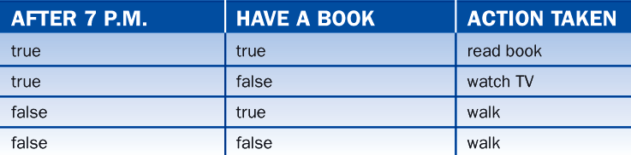
6.3 Nested if Statements
Although this code is not complicated, it is a little difficult to determine exactly what it means without the aid of the truth table illustrated in Table 6-6.

Slide 121
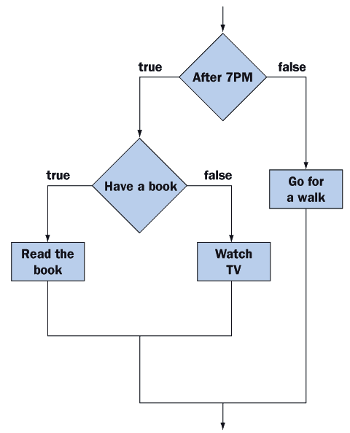
6.3 Nested if Statements
As a substitute for a truth table, we can draw a flowchart as shown in Figure 6-4.

Slide 122
6.4 Logical Errors in Nested ifs
Misplaced Braces
One of the most common mistakes involves misplaced braces.
// Version 1
if (the weather is wet){
if (you have an umbrella)
walk;
else
run;
}
// Version 2
if (the weather is wet){
if (you have an umbrella)
walk;
}else
run;

Slide 123
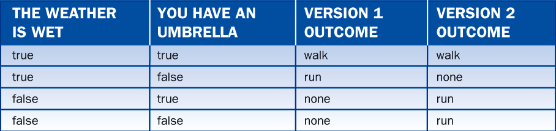
6.4 Logical Errors in Nested ifs
To demonstrate the differences between the two versions, we construct a truth table - as shown in Table 6-7:

Slide 124
6.4 Logical Errors in Nested ifs
Removing the Braces
When the braces are removed, Java pairs the else with the closest preceding if.
if (the weather is wet)
if (you have an umbrella)
walk;
else
run;

Slide 125
6.4 Logical Errors in Nested ifs
Computation of Sales Commissions
We now attempt to compute a salesperson's commission and introduce a logical error in the process.
Commissions are supposed to be computed as follows:
10% if sales are greater than or equal to $5,000
20% if sales are greater than or equal to $10,000
if (sales >= 5000)
commission = commission * 1.1; // line a
else if (sales >= 10000)
commission = commission * 1.2; // line b

Slide 126
6.4 Logical Errors in Nested ifs
To determine if the code works correctly, we check it against representative values for the sales, namely, sales that are:
less than $5,000,
equal to $5,000,
between $5,000 and $10,000,
equal to $10,000,
and greater than $10,000.
As we can see from Table 6-8, the code is not working correctly.

Slide 127
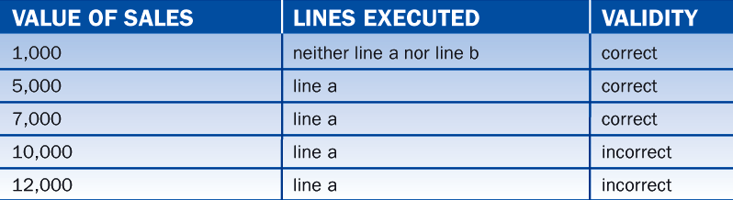
6.4 Logical Errors in Nested ifs

Slide 128
6.4 Logical Errors in Nested ifs
Corrected Computation of Sales Commissions
After a little reflection, we realize that the conditions are in the wrong order.
Here is the corrected code:
if (sales >= 10000)
commission = commission * 1.2; // line b
else if (sales >= 5000)
commission = commission * 1.1; // line a

Slide 129
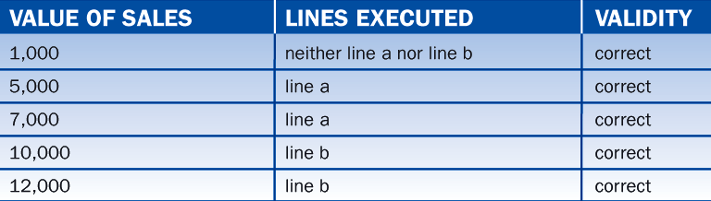
6.4 Logical Errors in Nested ifs
Table 6-9 confirms that the code now works correctly:

Slide 130
6.4 Logical Errors in Nested ifs
AVOIDING NESTED IFs
Sometimes getting rid of nested if's is the best way to avoid logical errors.
This is easily done by rewriting nested ifs as a sequence of independent if statements.
if (5000 <= sales && sales < 10000)
commission = commission * 1.1;
if (10000 <= sales)
commission = commission * 1.2;

Slide 131
6.4 Logical Errors in Nested ifs
And here is another example involving the calculation of student grades:
if (90 <= average ) grade is A;
if (80 <= average && average < 90) grade is B;
if (70 <= average && average < 80) grade is C;
if (60 <= average && average < 70) grade is D;
if ( average < 60) grade is F;

Slide 132
6.5 Nested Loops
There are many programming situations in which loops are nested within loops - these are called nested loops.
For example:
lower = reader.readInt("Enter the lower limit: ");
upper = reader.readInt("Enter the upper limit: ");
for (n = lower; n <= upper; n++){
innerLimit = (int)Math.sqrt (n);
for (d = 2; d <= innerLimit; d++){
if (n % d == 0)
break;
}
if (d > limit)
System.out.println (n + " is prime");
}

Slide 133
6.6 Testing Loops
The presence of looping statements in a program increases the challenge of designing good test data.
When designing test data, we want to cover all possibilities.
To illustrate, we develop test data for the print divisors program:
// Display the proper divisors of a number
n = reader.readInt("Enter a positive integer: ");
limit = n / 2;
for (d = 2; d <= limit; d++){
if (n % d == 0)
System.out.print (d + " ");
}

Slide 134
6.6 Testing Loops
By analyzing the code, we conclude that if n equals 0, 1, 2, or 3, the limit is less than 2, and the loop is never entered.
If n equals 4 or 5, the loop is entered once.
If n is greater than 5, the loop is entered multiple times.
All this suggests the test data shown in Table 6-10.

Slide 135
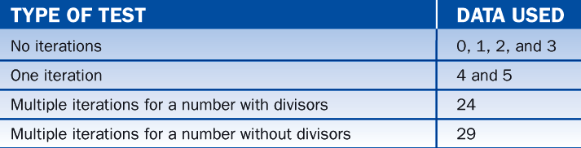
6.6 Testing Loops

Slide 136
Lesson 7: Improving the User Interface

Slide 137
Lesson 7: Improving the User Interface
Objectives:
Construct a query-driven terminal interface.
Construct a menu-driven terminal interface.
Construct a graphical user interface.
Position window objects in a grid within a window.
Write a method to handle users' interactions with command buttons.
Manipulate window objects to input and output integers, doubles, and text.

Slide 138
Lesson 7: Improving the User Interface
Vocabulary:
button object
double field object
integer field object
label object
message box
Metal
query-controlled input
structure chart
text area object
text field object
window object

Slide 139
7.1 A Thermometer Class
The demonstrations in this lesson all involve converting temperatures between Fahrenheit and Celsius.
To support these conversions we first introduce a Thermometer class.
This class stores the temperature internal in Celsius; however, the temperature can be set and retrieved in either Fahrenheit or Celsius.

Slide 140
7.1 A Thermometer Class
public class Thermometer {
private double degreesCelsius;
public void setCelsius(double degrees){
degreesCelsius = degrees;
}
public void setFahrenheit(double degrees){
degreesCelsius = (degrees - 32.0) * 5.0 / 9.0;
}
public double getCelsius(){
return degreesCelsius;
}
public double getFahrenheit(){
return degreesCelsius * 9.0 / 5.0 + 32.0;
}
}

Slide 141
7.2 Repeating Sets of Inputs and Type char
Another technique for handling repeating sets of inputs is called query controlled input.
Before each set of inputs, after the first, the program asks the user if there are more inputs.
Figure 7-1 shows an example:

Slide 142
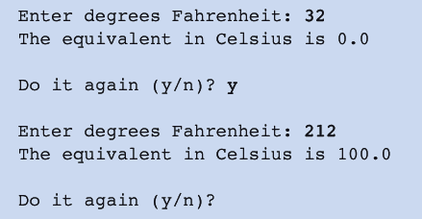
7.2 Repeating Sets of Inputs and Type char

Slide 143
7.2 Repeating Sets of Inputs and Type char
The program is implemented by means of two classes -- a class to handle the user interface and the Thermometer class.
Following is pseudocode for the interface class:
instantiate a thermometer
char doItAgain = 'y'
while (doItAgain equals 'y' or 'Y'){
read degrees Fahrenheit and set the thermometer
ask the thermometer for the degrees in Celsius and display
read doItAgain //The user responds with 'y' or 'n'
}

Slide 144
7.2 Repeating Sets of Inputs and Type char
The key to this pseudocode is the character variable doItAgain.
This variable controls how many times the loop repeats.
Initially, the variable equals 'y'.
As soon as the user enters a character other than 'y' or 'Y', the program terminates.
Here is a complete listing of the interface class:

Slide 145
7.2 Repeating Sets of Inputs and Type char
/* ConvertWithQuery.java
Repeatedly convert from Fahrenheit to Celsius until the user
signals the end.
*/
import TerminalIO.*;
public class ConvertWithQuery {
public static void main (String [] args) {
KeyboardReader reader = new KeyboardReader();
Thermometer thermo = new Thermometer();
char doItAgain = 'y';
while (doItAgain == 'y' || doItAgain == 'Y'){
thermo.setFahrenheit
(reader.readDouble("\nEnter degrees Fahrenheit: "));
System.out.println
("The equivalent in Celsius is " + thermo.getCelsius());
doItAgain = reader.readChar("\nDo it again (y/n)? ");
}
}
}

Slide 146
7.2 Repeating Sets of Inputs and Type char
In the previous code, observe that a character literal is enclosed within apostrophes.
A character variable holds a single character and is declared using the keyword char.
The readChar method reads the first character entered on a line.
'Y' and 'y' are not the same character.

Slide 147
7.3 A Menu-Driven Conversion Program
Menu-driven programs begin by displaying a list of options from which the user selects one.
The program then prompts for additional inputs related to that option and performs the needed computations, after which it displays the menu again.
Figure 7-2 shows how this idea can be used to extend the temperature conversion program.

Slide 148
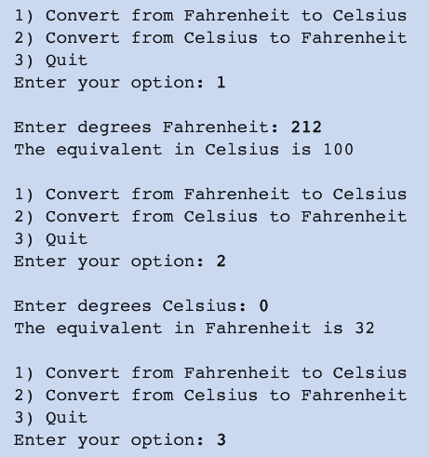
7.3 A Menu-Driven Conversion Program

Slide 149
7.3 A Menu-Driven Conversion Program
Following is the corresponding pseudocode followed by the program:
instantiate a thermometer
menuOption = 4
while (menuOption != 3){
print menu
read menuOption
if (menuOption == 1){
read fahrenheit and set the thermometer
ask the thermometer to convert and print the results
}else if (menuOption == 2){
read celsius and set the thermometer
ask the thermometer to convert and print the results
}else if (menuOption != 3)
print "Invalid option"
}

Slide 150
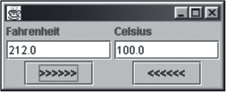
7.4 A GUI-Based Conversion Program
The BreezySwing package extends Java's built-in facilities for creating GUIs in a manner that is powerful yet easy to use.
Figure 7-3 shows the interface for a GUI-based temperature conversion program.

Slide 151
7.4 A GUI-Based Conversion Program
To use the program, we enter a temperature in one of the fields and click the button below it.
The converted temperature is then displayed in the other field.
We repeat the process as many times as desired and click the close icon when finished (top right corner).

Slide 152
7.4 A GUI-Based Conversion Program
Following is a listing of the program:
Code and comments in blue indicate features that are common to all GUI programs.
A detailed explanation follows the code.
/* ConvertWithGUI.java
A GUI-based temperature conversion program that coverts from
Fahrenheit to Celsius and vice versa.
*/
import javax.swing.*;
import BreezySwing.*;
public class ConvertWithGUI extends GBFrame{

Slide 153
7.4 A GUI-Based Conversion Program
// Declare variables for the window objects.
private JLabel fahrenheitLabel;
private JLabel celsiusLabel;
private DoubleField fahrenheitField;
private DoubleField celsiusField;
private JButton fahrenheitButton;
private JButton celsiusButton;
// Constructor
public ConvertWithGUI(){
// Instantiate and add window objects to the window.
fahrenheitLabel = addLabel ("Fahrenheit" ,1,1,1,1);
celsiusLabel = addLabel ("Celsius" ,1,2,1,1);
fahrenheitField = addDoubleField (32.0 ,2,1,1,1);
celsiusField = addDoubleField (0.0 ,2,2,1,1);
fahrenheitButton = addButton (">>>>>>" ,3,1,1,1);
celsiusButton = addButton ("<<<<<<" ,3,2,1,1);
}

Slide 154
7.4 A GUI-Based Conversion Program
// Respond to button click events
public void buttonClicked (JButton buttonObj){
// Local variables
Thermometer thermo = new Thermometer();
// Determine which button was clicked.
if (buttonObj == fahrenheitButton){
// Convert from Fahrenheit to Celsius
thermo.setFahrenheit(fahrenheitField.getNumber());
celsiusField.setNumber (thermo.getCelsius());
}else{

Slide 155
7.4 A GUI-Based Conversion Program
// Convert Celsius to Fahrenheit
thermo.setCelsius(celsiusField.getNumber());
fahrenheitField.setNumber (thermo.getFahrenheit());
}
}
// Execution begins in the method main as usual.
public static void main (String[] args){
ConvertWithGUI theGUI = new ConvertWithGUI();
theGUI.setSize (250, 100); //Set the window's size in pixels
// width = 250, height = 100
theGUI.setVisible (true); //Make the window visible
}
}

Slide 156
7.5 The GUI Program Explained
Program execution begins as usual in method main.
The theGUI object is instantiated and sent the setSize and setVisible messages.
The setSize message indicates the size of the window as measured in pixels.
The first parameter indicates the width and the second the height.
A window is invisible until it receives a setVisible(true) message.
Once the window is visible, there are no more statements to execute in main, and execution in main terminates; however, the program does not end.
Instead it becomes inactive until the user clicks a command button or the GUI's close-icon.

Slide 157
7.5 The GUI Program Explained
As soon as theGUI object is instantiated, the constructor executes and the window objects are instantiated and added to the window.
These window objects represent the labels, data entry fields, and command buttons that comprise the constituent components of the window.

Slide 158
7.5 The GUI Program Explained
Every time the user clicks a command button, the JVM sends the buttonClicked message to the theGUI object.
Execution then begins anew in the theGUI object's buttonClicked method, proceeds through the method until the last line has been executed, and terminates.
The program then becomes inactive again.
When the user clicks the GUI's close icon, the program ends.

Slide 159
7.5 The GUI Program Explained
Line by Line Explanation
Following is a line-by-line explanation of the code.
IMPORTING PACKAGES
GUI programs must import the two packages javax.swing and BreezySwing.
These packages contain classes that support the overall behavior of a GUI-based program and its window objects.
import javax.swing.*;
import BreezySwing.*;

Slide 160
7.5 The GUI Program Explained
GBFrame
A GUI program must be a subclass of GBFrame.
public class ConvertWithGUI extends GBFrame{

Slide 161
7.5 The GUI Program Explained
Declare Window Object Variable
// Declare variables for the window objects.
private JLabel fahrenheitLabel;
private JLabel celsiusLabel;
private DoubleField fahrenheitField;
private DoubleField celsiusField;
private JButton fahrenheitButton;
private JButton celsiusButton;

Slide 162
7.5 The GUI Program Explained
The Add Method
// Constructor
public ConvertWithGUI(){
// Instantiate and add window objects to the window.
fahrenheitLabel = addLabel ("Fahrenheit" ,1,1,1,1);
celsiusLabel = addLabel ("Celsius" ,1,2,1,1);
fahrenheitField = addDoubleField (32.0 ,2,1,1,1);
celsiusField = addDoubleField (0.0 ,2,2,1,1);
fahrenheitButton = addButton (">>>>>>" ,3,1,1,1);
celsiusButton = addButton ("<<<<<<" ,3,2,1,1);
}

Slide 163
7.5 The GUI Program Explained
The add methods instantiate, initialize, and position the window objects.
Each type of window object has a different purpose:
A label object displays text in the window. This text is normally used to label some other window object, such as a data entry or data display field.
A double field object can accept user input and/or display program output.
A button object activates the buttonClicked method when clicked by the user.

Slide 164
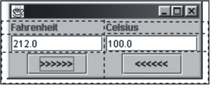
7.5 The GUI Program Explained
Window objects are positioned in an imaginary grid (see Figure 7-4), and the grid automatically adjusts itself to the needed number of rows and columns.

Slide 165
7.5 The GUI Program Explained
The syntax for adding a window object indicates its position and size in this grid:
<name of object> = add<type>
(<initial value>, //An object's initial value varies depending on type.
<row #>, //Row position in grid. Our example has 3 rows.
<column #>, //Column position in grid. Our example has 2 columns.
<width>, //Width of object, usually 1 grid cell.
<height>); //Height of object, usually 1 grid cell.

Slide 166
7.5 The GUI Program Explained
Button Click Events
When the user clicks a command button, the JVM sends the buttonClicked message to the theGUI object.
These lines begin the method's definition.
Notice that the method has one parameter, a button object.
When the method is called, this parameter corresponds to the button clicked by the user.
// Respond to button click events
public void buttonClicked (JButton buttonObj){

Slide 167
7.5 The GUI Program Explained
Declare Local Variables
Here we declare variables that are local to the buttonClicked method.
// Local variables
Thermometer thermo = new Thermometer();

Slide 168
7.5 The GUI Program Explained
Determine Button Clicked
Here we determine if the button clicked by the user equals the fahrenheitButton.
In general, there can be any number of command buttons in a window.
// Determine which button was clicked.
if (buttonObj == fahrenheitButton){

Slide 169
7.5 The GUI Program Explained
Read and Write Numbers
The getNumber and setNumber methods read and write numbers from and to numeric fields, respectively.
//Convert from Fahrenheit to Celsius
thermo.setFahrenheit(fahrenheitField.getNumber());
celsiusField.setNumber (thermo.getCelsius());

Slide 170
7.6 Other Window Objects and Methods
All the methods for adding window objects to the user interface and for responding to user events are part of BreezySwing.
The window objects themselves are either part of Swing or are derived from objects in Swing.
For instance:
labels and command buttons are part of Swing
double fields are derived from Swing's standard text fields.
Programs that use Swing must import javax.swing.*
Programs that use BreezySwing must also import BreezySwing.*.

Slide 171
7.6 Other Window Objects and Methods
Integer Field Objects
An object of class IntegerField is called an integer field object, and it can be used to enter or display an integer value.
An integer field should always be initialized to an integer and never to a floating-point value.
The principal methods for manipulating integer fields are:
int getNumber()
which reads an integer from an input field
void setNumber(anInteger)
which prints a number in an output field

Slide 172
7.6 Other Window Objects and Methods
The same method names are used for manipulating double fields.
Using the same method name with different classes is called polymorphism.

Slide 173
7.6 Other Window Objects and Methods
Text Field Objects
An object of class JTextField is called a text field object and can hold one line of string data.
A text field is useful for entering or displaying such things as names and descriptions.
It must be initialized to a string.
The principal methods for manipulating text fields are:
String getText()
which reads a string from an input field
void setText(aString)
which prints a one-line string in an output field

Slide 174
7.6 Other Window Objects and Methods
Text Area Objects
An object of class JTextArea is called a text area object and is similar to a text field object except that it can handle several lines of text at a time.
A text area can be used for entering or displaying a person's address or any other multiline descriptive information.
A text area is usually several cells wide and high.

Slide 175
7.6 Other Window Objects and Methods
The principal methods for manipulating a text area are:
String getText()
which reads a multiline string from an input field
void setText(aString)
which prints a multiline string in an output field
void append(aString)
which appends a multiline string to the end of the text already present in the output field

Slide 176
7.6 Other Window Objects and Methods
Summary of Methods
Table 7-1 contains a summary of the methods discussed so far together with several new methods:

Slide 177
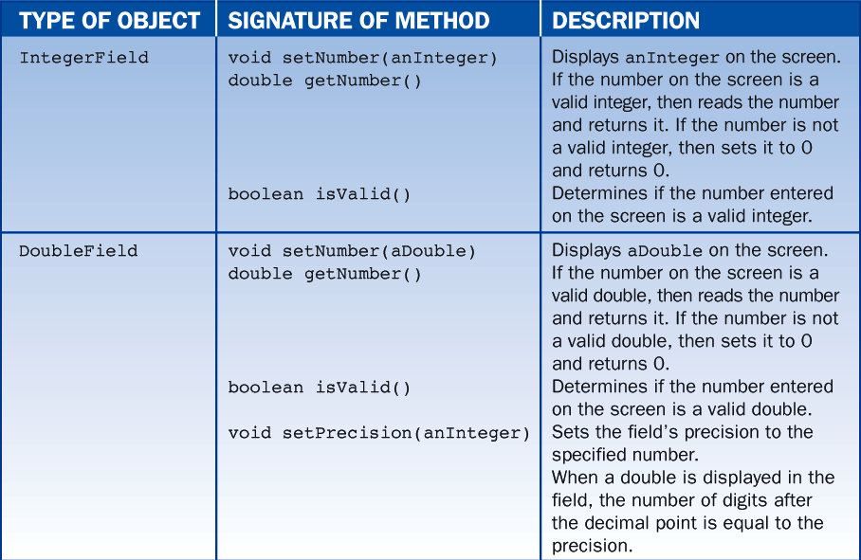
7.6 Other Window Objects and Methods

Slide 178
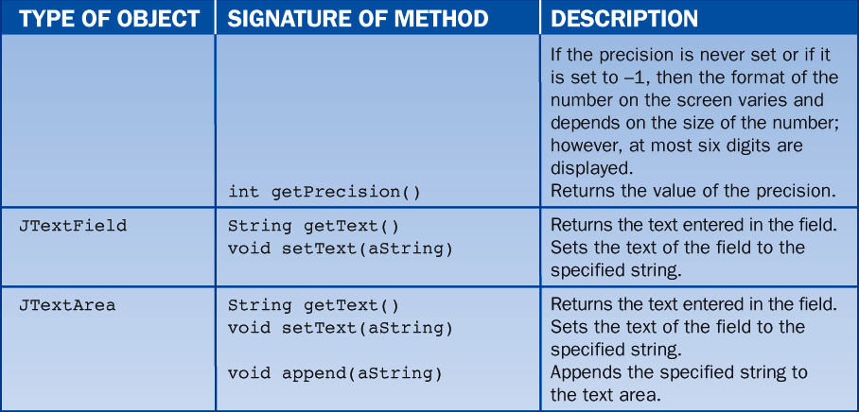
7.6 Other Window Objects and Methods

Slide 179
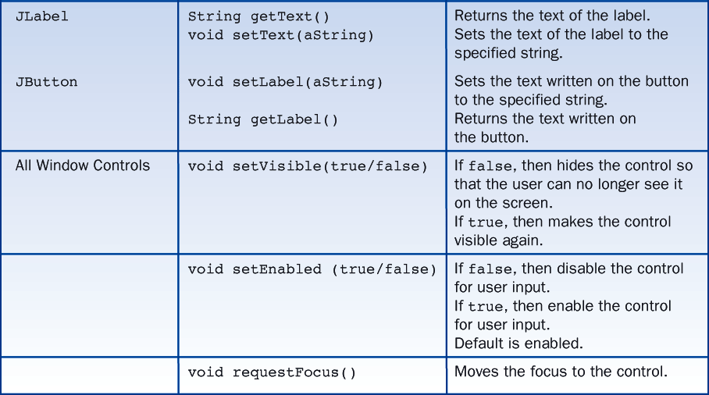
7.6 Other Window Objects and Methods

Slide 180
7.6 Other Window Objects and Methods
Declaring Window objects
Following is a list that shows how to instantiate the window objects discussed so far:
aLabel = addLabel ("..." ,r,c,w,h);
anInteger = addIntegerField (<integer>,r,c,w,h);
aDouble = addDoubleField (<double> ,r,c,w,h);
aJTextField = addTextField ("..." ,r,c,w,h);
aJTextArea = addTextArea ("..." ,r,c,w,h);
aJButton = addButton ("..." ,r,c,w,h);

Slide 181
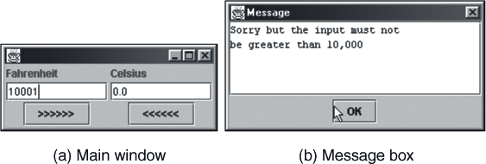
7.6 Other Window Objects and Methods
The messageBox Method
A message box is a convenient device for popping up messages outside an application's main window.

Slide 182
7.6 Other Window Objects and Methods
The code for activating a message box always appears inside a GUI class, which in our example is the ConvertWithGUI class.
The key piece of code consists of sending the message messageBox to the object this:
In the line of code, the word this refers to the theGUI object itself.
For the convenience of programmers, Java allows the word this to be omitted, so the code can be written as:
this.messageBox ("Sorry but the input must not \nbe greater than 10,000");
messageBox ("Sorry but the input must not \nbe greater than 10,000");

Slide 183
7.6 Other Window Objects and Methods
Another version of messageBox allows the programmer to specify the box's height and width in pixels.
The following code displays the message "Hello world!" in a box that is 300 pixels wide and 100 pixels high:
messageBox ("Hello world!", 300, 100);

Slide 184
7.6 Other Window Objects and Methods
Setting the Look and Feel
Each GUI-based operating system, such as Windows, MacOS, and Motif (for UNIX), has its own look and feel.
Java's Swing toolkit provides a default look and feel called Metal.
Swing allows the programmer to set the look and feel of a window as well as any all of its subcomponents.
To accomplish this with BreezySwing, we call the method setLookAndFeel with the String parameter "METAL", "MOTIF", or "OTHER".

Slide 185
7.6 Other Window Objects and Methods
On a Windows system, "OTHER" changes the look and feel to Windows.
Method main is a convenient place to call the setLookAndFeel method.
The following code segment shows how to do this in the temperature conversion program:
public static void main (String[] args){
ConvertWithGUI theGUI = new ConvertWithGUI();
theGUI.setLookAndFeel("MOTIF");
theGUI.setSize (250, 100); //Set the window's size in pixels
theGUI.setVisible (true); //Make the window visible
}

Slide 186
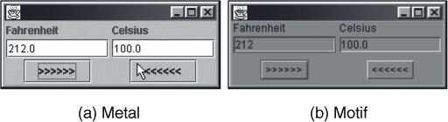
7.6 Other Window Objects and Methods
Figure 7-6 compares the Metal look and the Motif look:

Slide 187
7.7 Formatted Output
Figure 7-7 shows a table of names, sales, and commissions, with and without formatting.
Although both tables contain exactly the same data, only the formatted one is readable.
The key feature of a formatted table is that each column has a designated width, and all the values in a column are justified in the same manner.

Slide 188
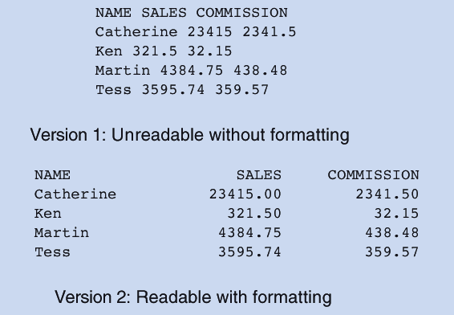
7.7 Formatted Output

Slide 189
7.7 Formatted Output
Format, a class in BreezySwing, contains a method called justify that supports the process of positioning values in fields.
The justify method can position a value left, right, or center within a field of some designated width.
Table 7-2 shows words and numbers justified in fields of width 10.

Slide 190
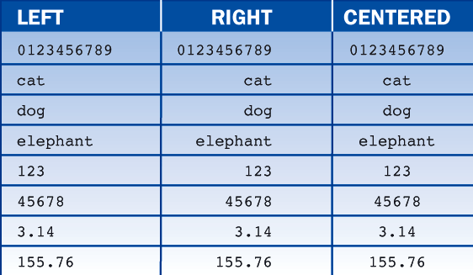
7.7 Formatted Output

Slide 191
7.7 Formatted Output
Here is a code segment that embeds the word "cat" left justified in a string of length 8 together with several other examples:
import BreezySwing.Format;
. . .
Format.justify ('l', "cat", 8); // "cat" left justified in a string of
// length 8 yields the string
// "cat "
Format.justify ('r', 45678, 7); // 45678 right justified in a string of
// length 7 yields the string
// " 45678"
Format.justify ('c', "dog", 11); // "dog" centered in a string of
// length 11 yields the string
// " dog "
Format.justify ('r', 2.534, 10, 2); // 2.534 right justified in a string of
// length 10 with a precision of 2 yields
// " 2.53"

Slide 192
7.7 Formatted Output
In the code, the justify message is sent, not to an object, but to the class Format.
When using the justify method, we need to be aware that it comes in four slightly different flavors, as described in Table 7-3.

Slide 193
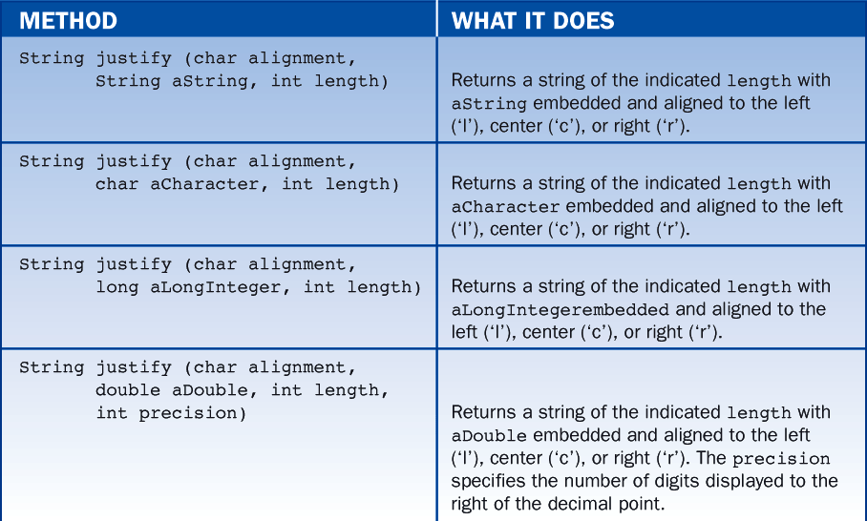
7.7 Formatted Output

Slide 194
7.8 GUIs and Applets
An applet is a Java program that runs in a Web browser.
Instead of running in a terminal window, an applet has a graphical user interface that appears embedded in the Web page.
Many Java applications can be converted into applets.

